Slide 1
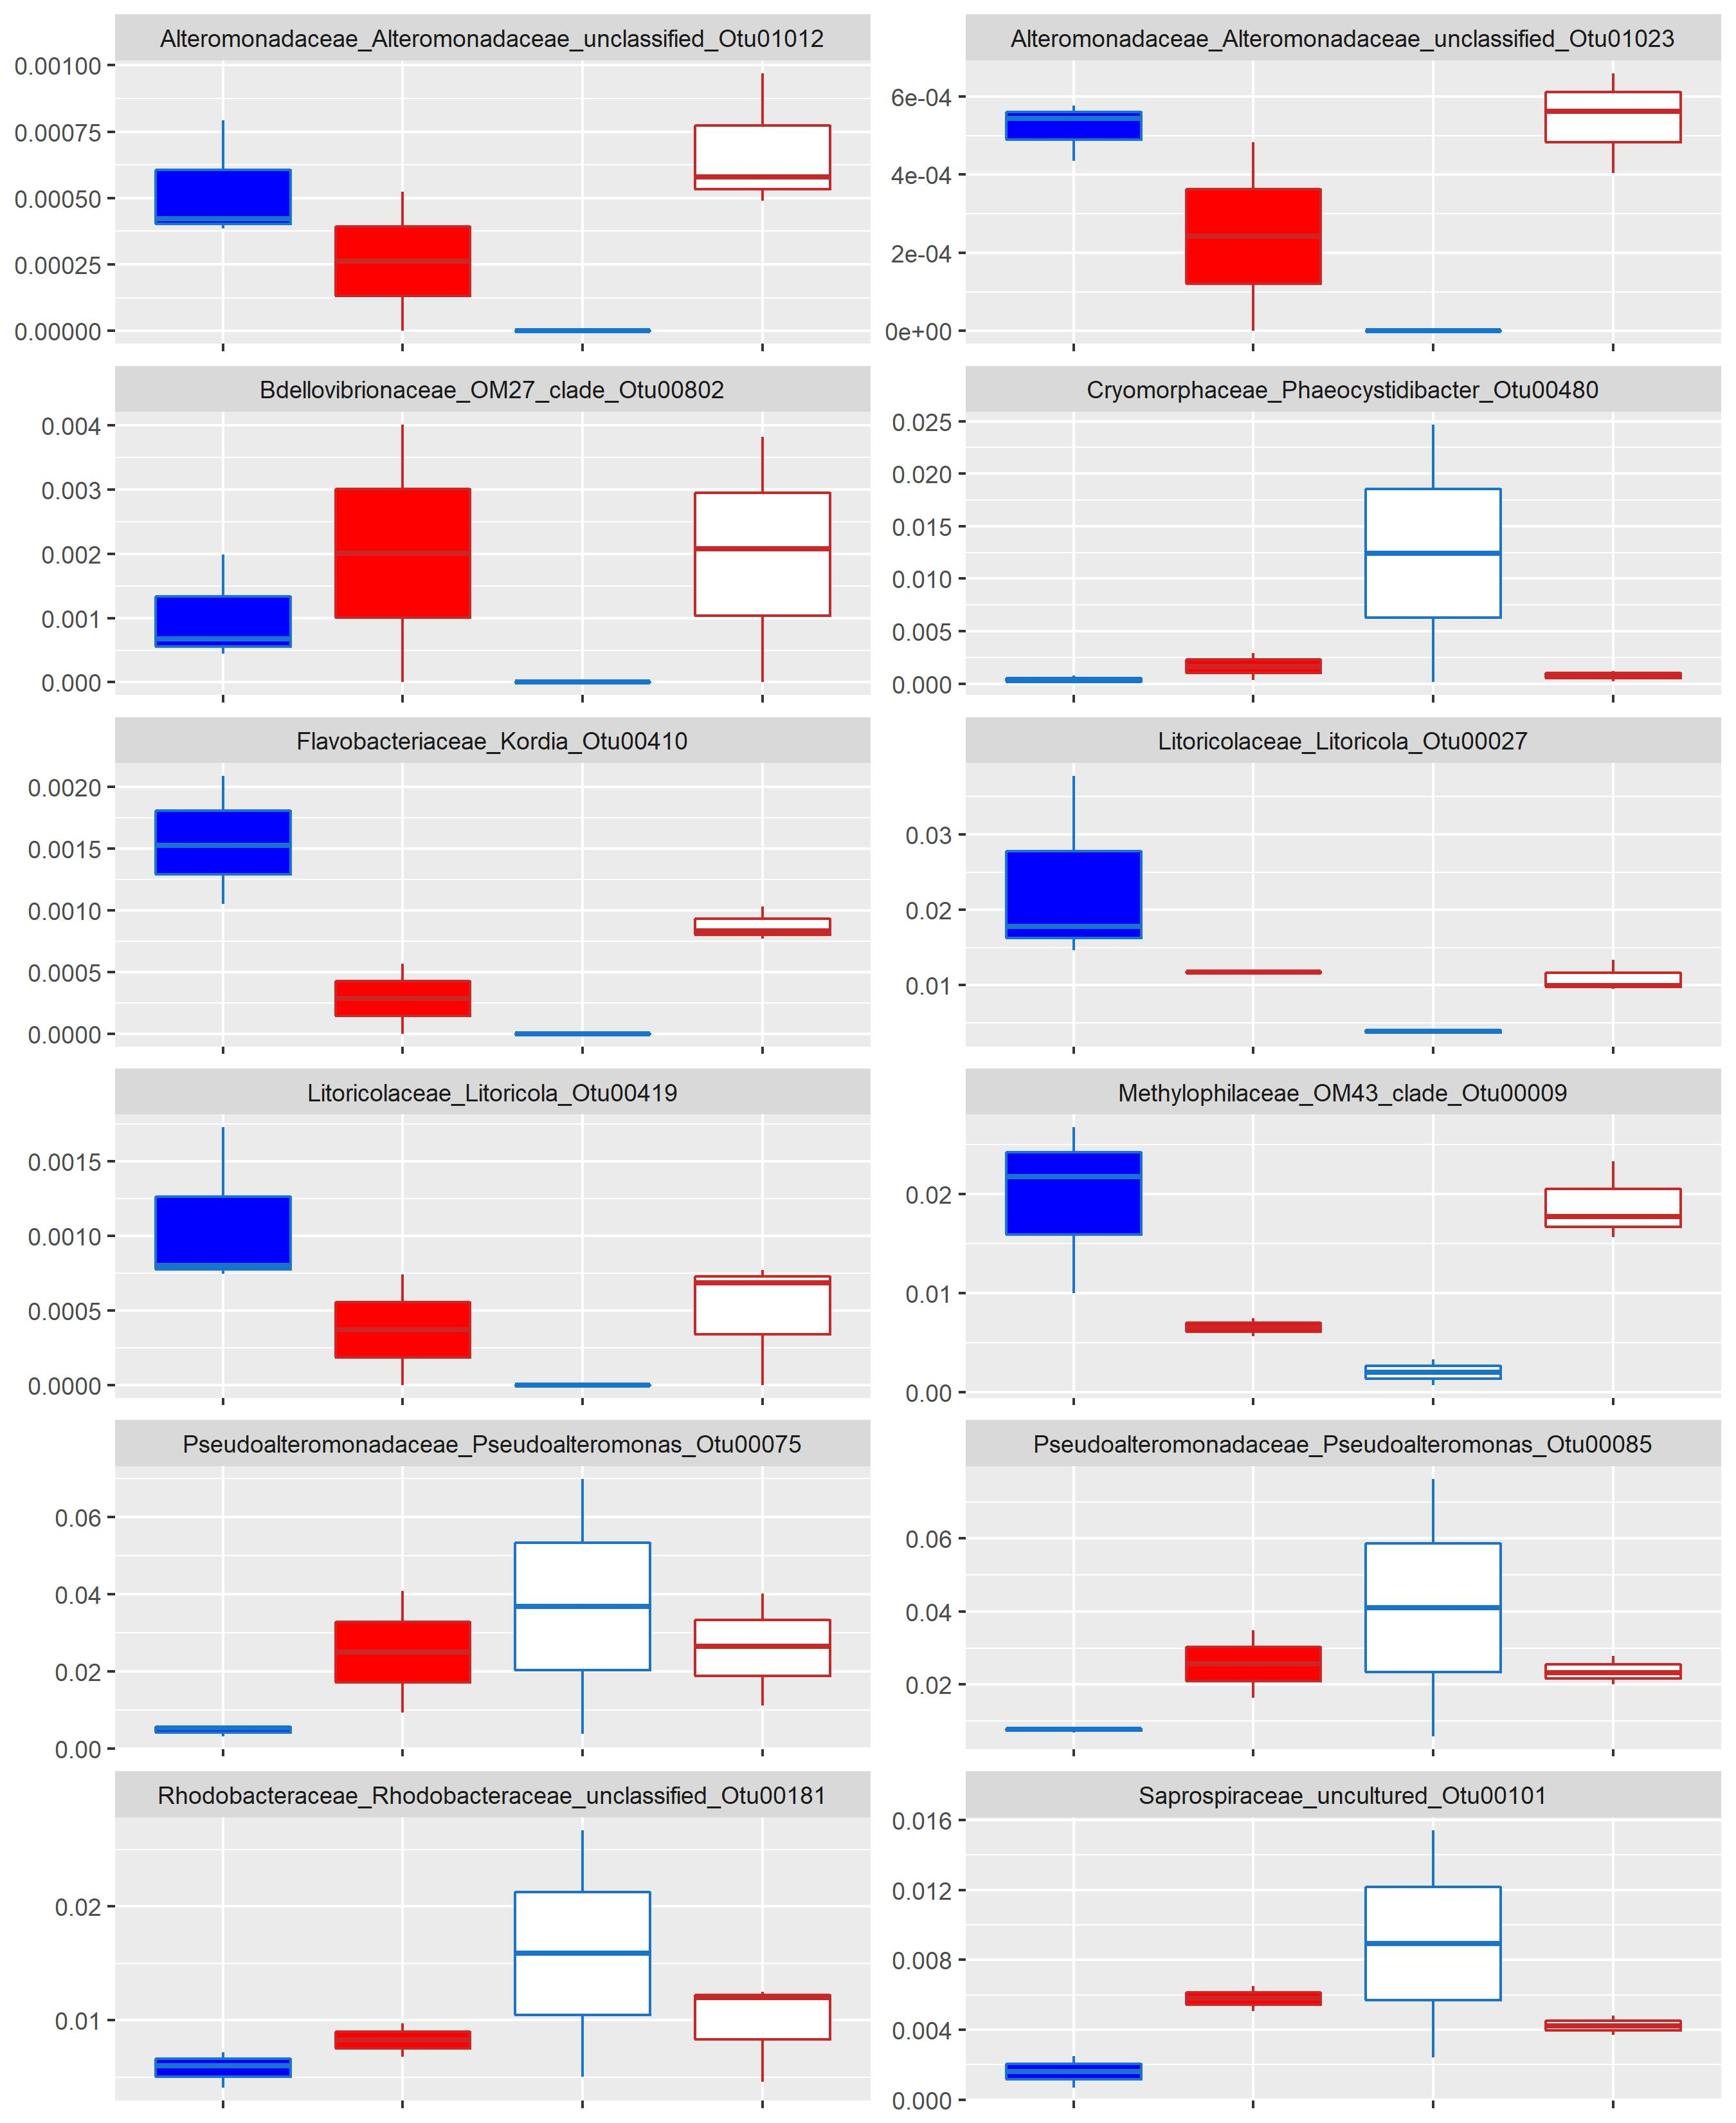
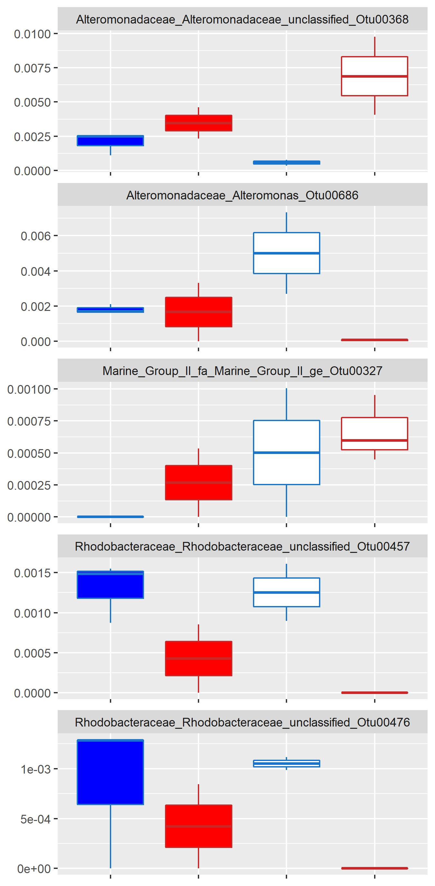
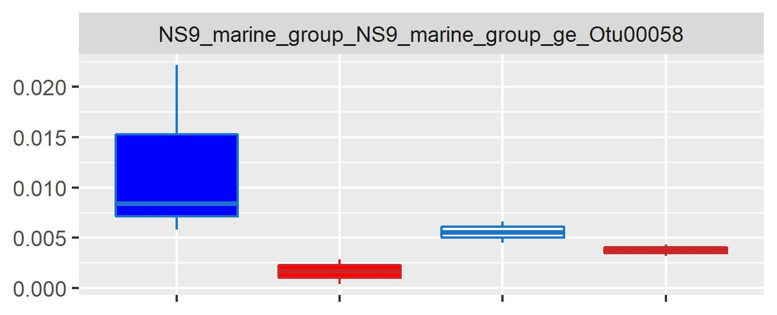
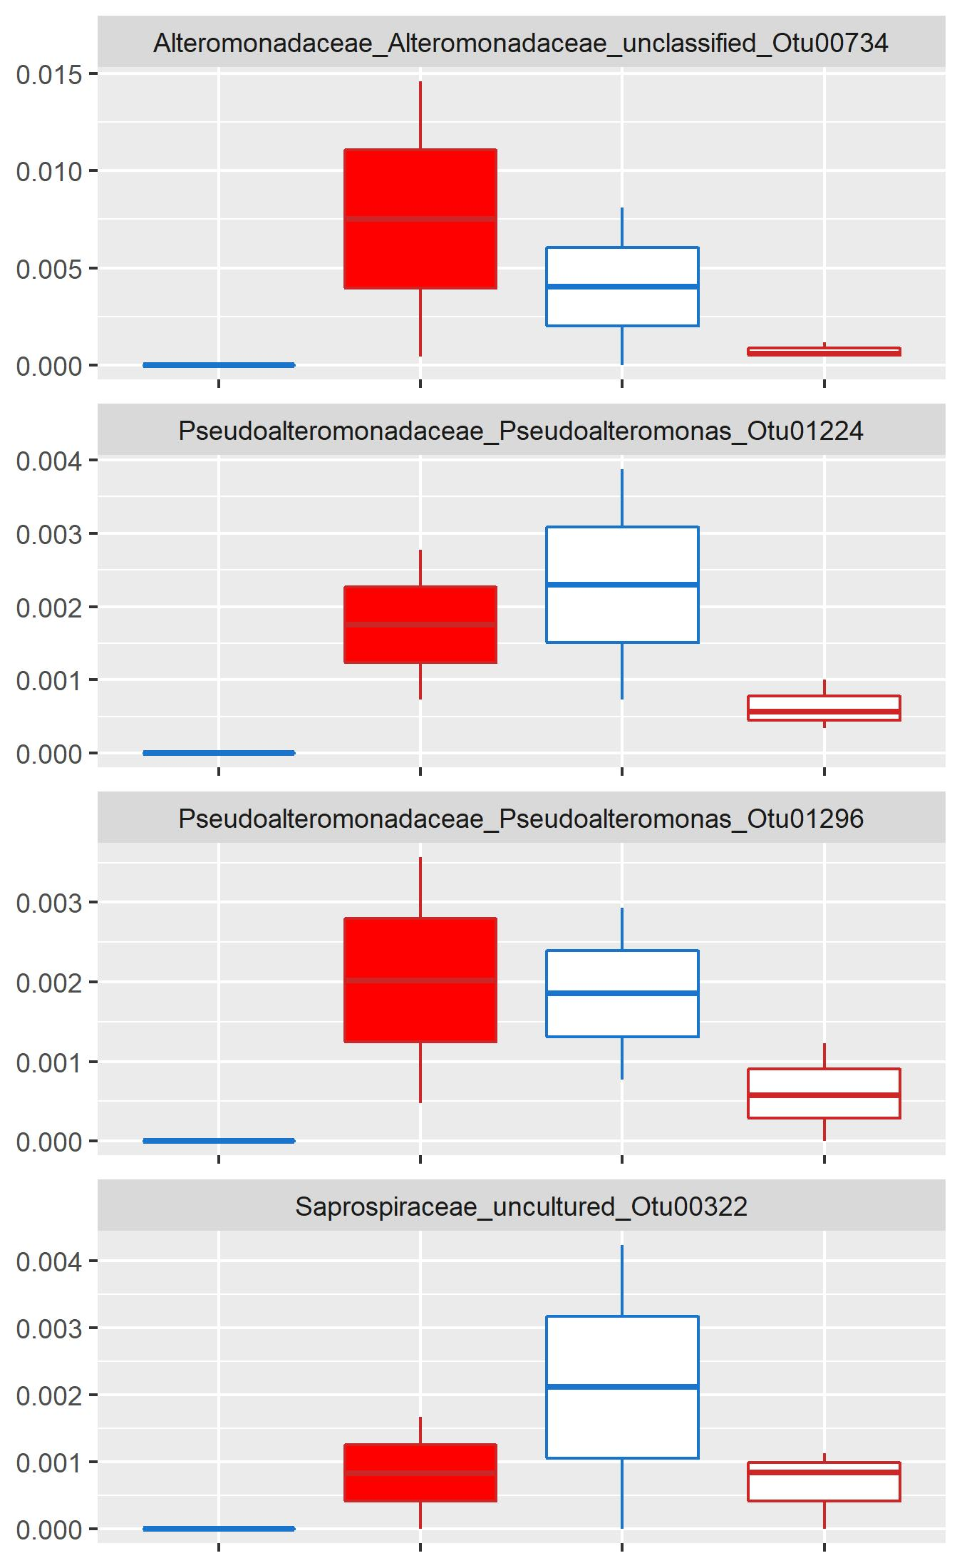
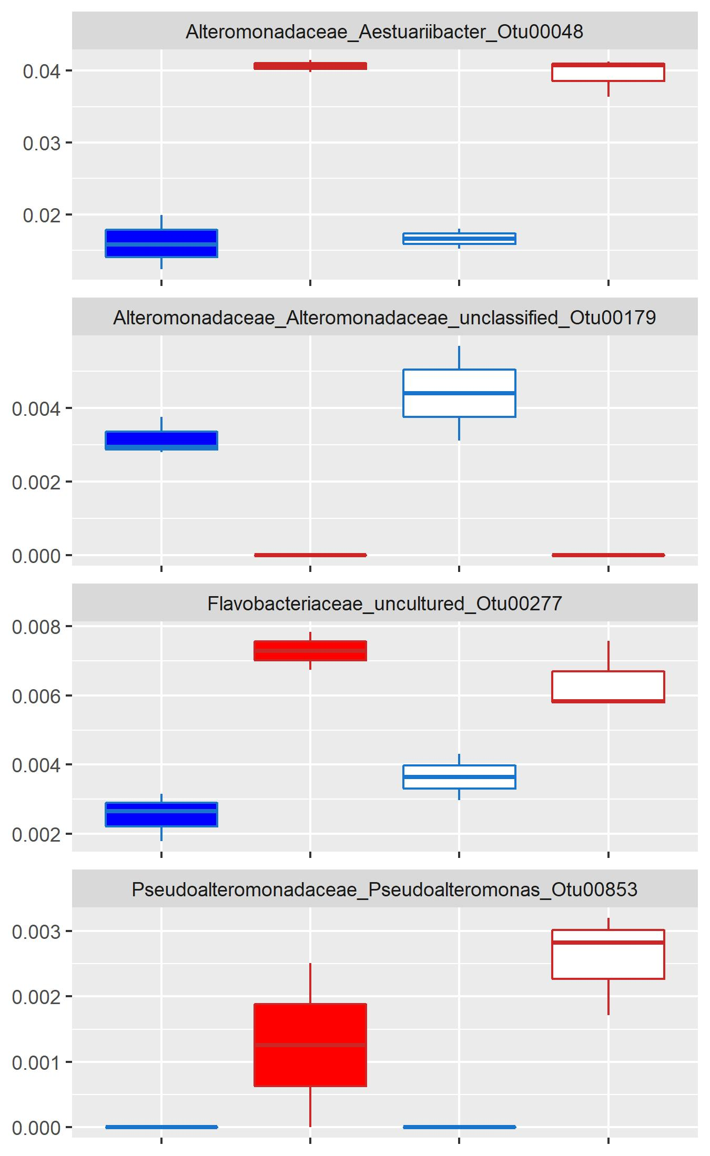
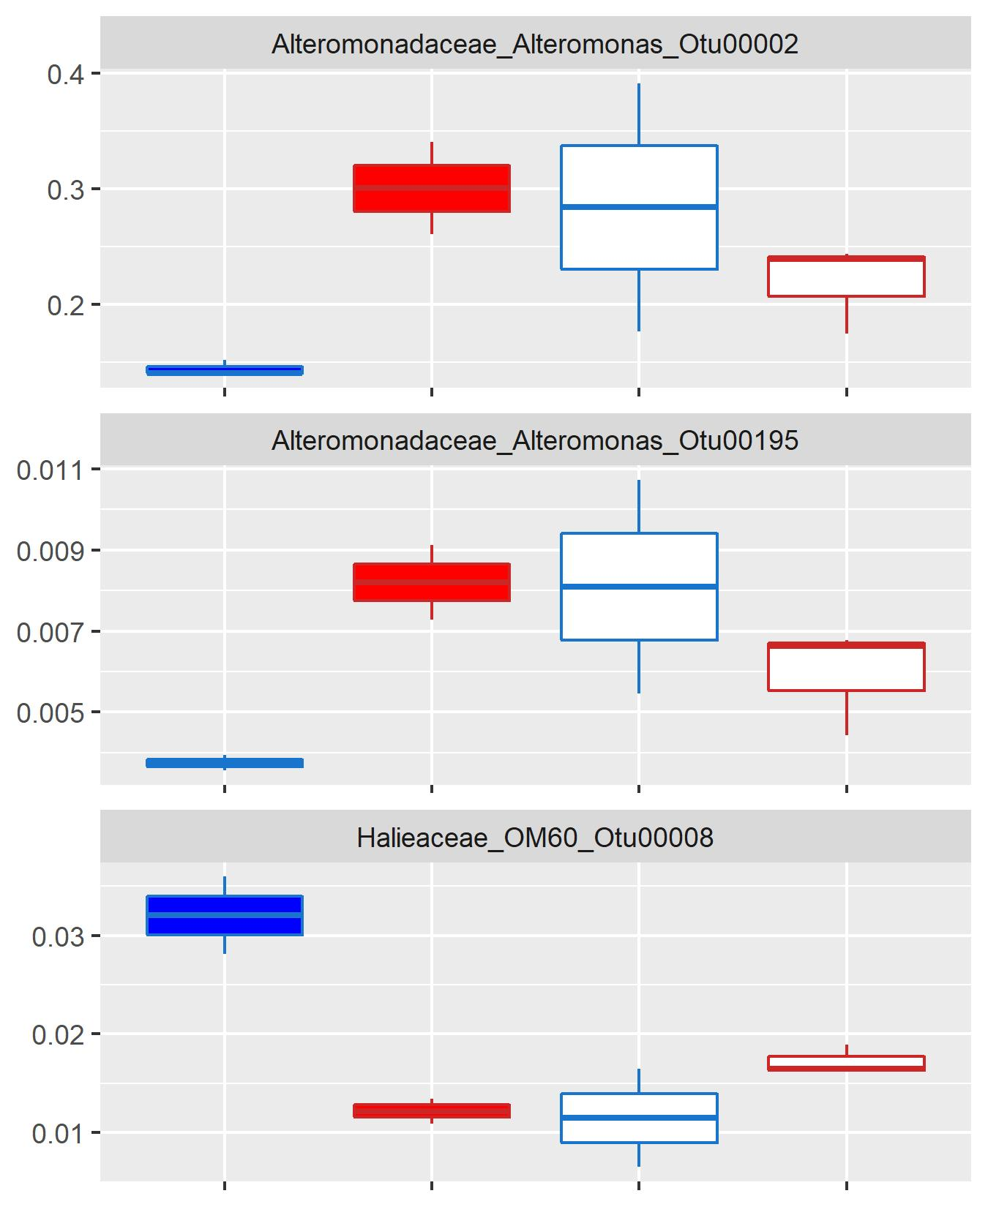
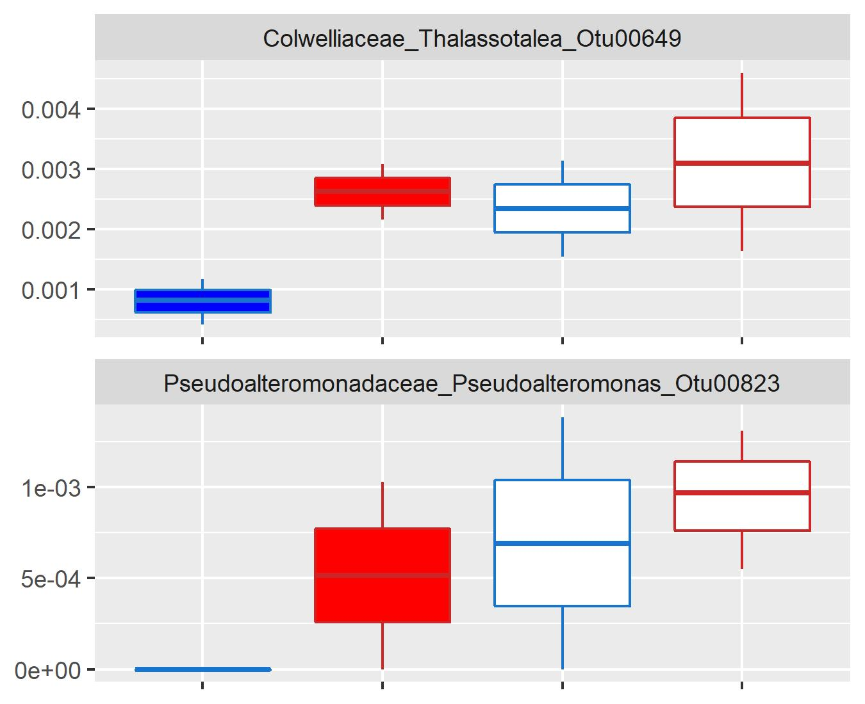
DA ASVs in a single treatment
Bleached + Ambient
Bleached + Heated
Non-bleached + Heated
Relative Abundance
DA ASVs in multiple treatments
Non-bleached + Heated
Bleached + Heated
Bleached Ambient
Non-bleached + Heated
Bleached + Heated
Non-bleached + Heated
Bleached + Ambient
Bleached + Ambient
Bleached + Heated
Relative Abundance

